Slide 1
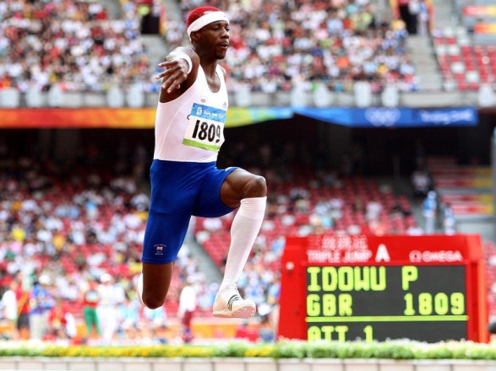
Training Methods & Fitness Requirements
Joe Lawrence – Triple Jump

Slide 2
Learning Objectives
To be able to explain the importance of different components of fitness for a triple jumper.
Describe the different training methods required for a triple jumper to achieve excellence.

Slide 3
At the start of the lesson I knew ….. about training methods and fitness requirements of a triple jumper Now I know …….. about training methods and fitness requirements of a triple jumper At the start of the lesson I was working at Grade …… To get to Grade ……. I need to…….. I have made some/good /excellent PROGRESS
Progress Check

Slide 4
Training Methods
Component of Fitness | Training Method
Flexibility | Static
 | Active/dynamic
 | Passive
 | Ballistic (This can cause injuries if done incorrectly)
Muscular Strength | Use of resistance machines
Muscular Endurance | Use of free weights
 | Circuit training
Power | Plymetric training (power)
Aerobic Endurance | Continuous training
 | Fartlek training
 | Interval training
Speed | Hollow sprints
 | Acceleration Sprints
 | Hill Sprints

Slide 5
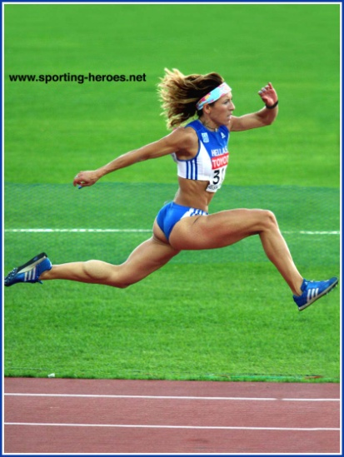
Fitness Requirements
physical fitness
aerobic endurance, muscular endurance, flexibility, speed, strength, body composition
skill-related fitness
agility, balance, coordination, power, reaction time

Slide 6
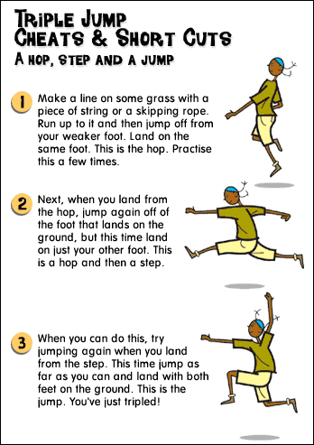
Tasks:
You are to select one of our talented athletes within school and produce a poster which could be displayed in the changing rooms. This poster should:
Describe the fitness requirements for achieving excellence in the selected sport P1
Reference must be made to the following components of fitness: physical fitness (aerobic endurance, muscular endurance, flexibility, speed, strength, body composition); skill-related fitness (agility, balance, coordination, power, reaction time)
Explain in more detail the importance of the components of fitness for the selected sport M1
Describe three different fitness training methods used to achieve excellence in the selected sport. P2
Fitness training methods: e.g. flexibility training (static, active, passive, ballistic), strength and power training (resistance machines, circuit training, plyometrics, reps, sets and resistance), endurance training (continuous training, fartlek training, interval training, heart rate, training zones), speed and speed endurance (hollow sprints, acceleration sprints, interval training)

Slide 7
Learning Objectives
To be able to explain the importance of different components of fitness for a triple jumper.
Describe the different training methods required for a triple jumper to achieve excellence.

Slide 8
At the start of the lesson I knew ….. about training methods and fitness requirements of a triple jumper Now I know …….. about training methods and fitness requirements of a triple jumper At the start of the lesson I was working at Grade …… To get to Grade ……. I need to…….. I have made some/good /excellent PROGRESS
Progress Check

